Slide 1

PRESENTING “GENERATIVE AI”
Exploring How AI Creates New Content
PRESENTED
BY:
WASIF ALI
SAAD ALI
MALIK UZAIR

Slide 2



INTRODUCTION
Generative AI is a type of artificial intelligence that can create new content like text, images, music, and more by learning patterns from existing data.
It generates creative and unique outputs based on the instructions it receives.
Key Features:
Learns from large datasets.
Generates creative and realistic outputs.
Mimics human-like creativity.
1/8

Slide 3
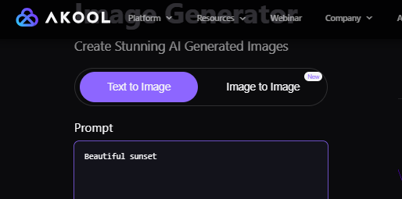

How Generative AI Works?
Data Collection & Analysis
Learning Patterns
Uses Powerful Models:
GPT, BERT
GANs , AKOOL
Generates New Outputs
Image showing how data leads to AI-generated content.
2/8

Slide 4




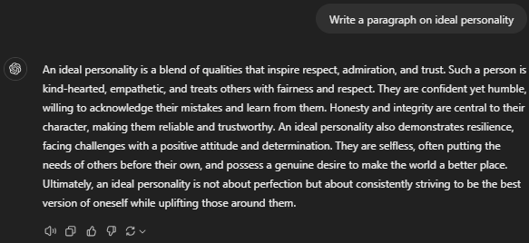
Applications of Generative AI
Text (GPT , Black Box): Writing stories, summaries, coding.
Images (GANs , AKOOL): Art, product design, marketing materials.
Music (Beatoven , Brev): Composing tunes, soundscapes.
Video (Canva , InVideo): Animation, virtual environments.
Other: Data augmentation, personalized recommendations.
3/8

Slide 5
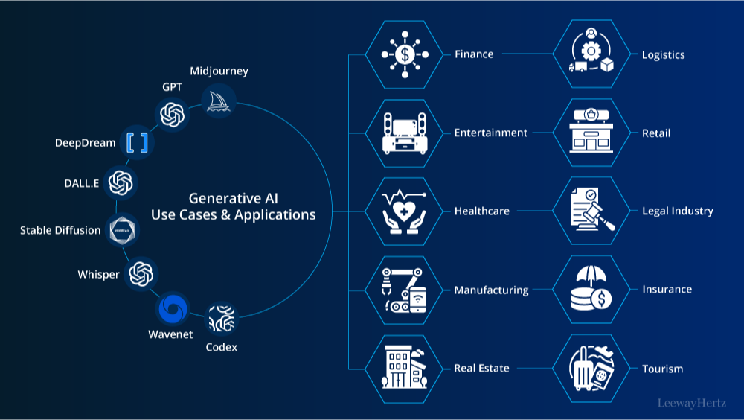
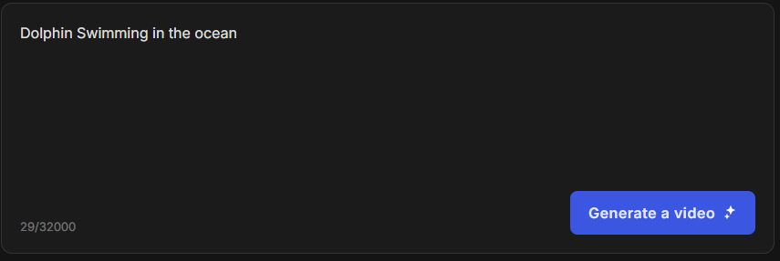
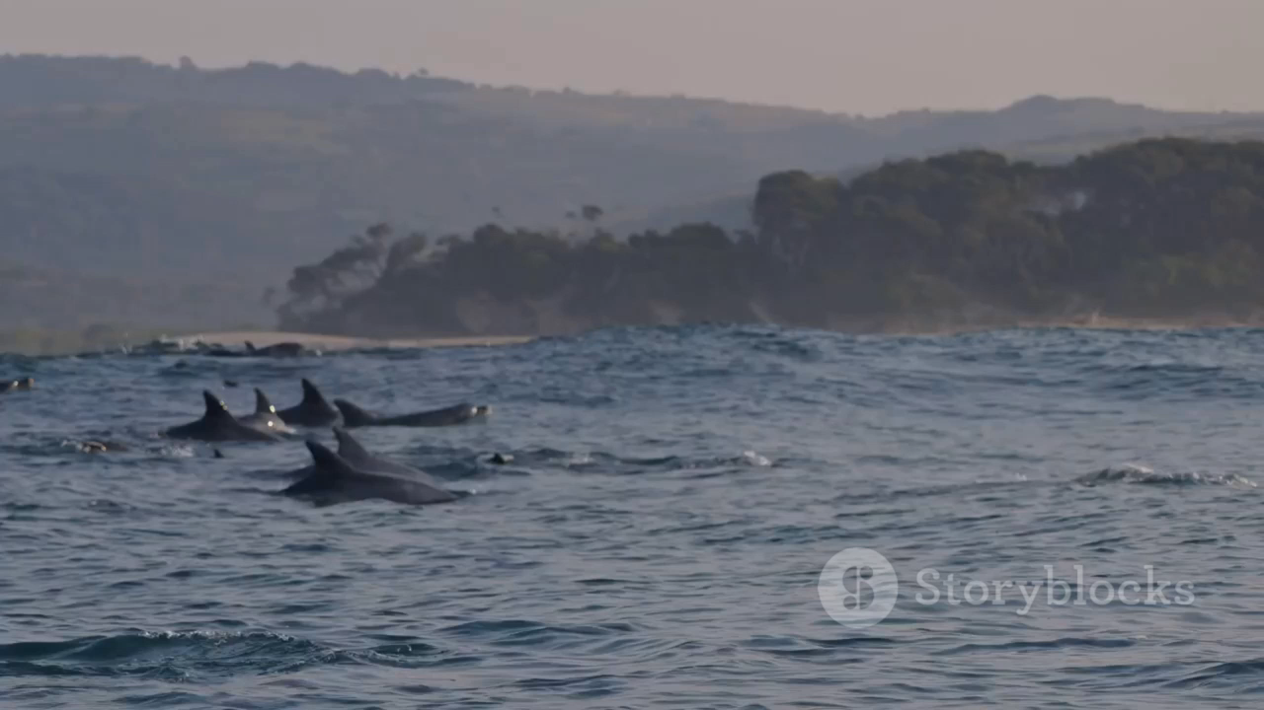

4/8

Slide 6
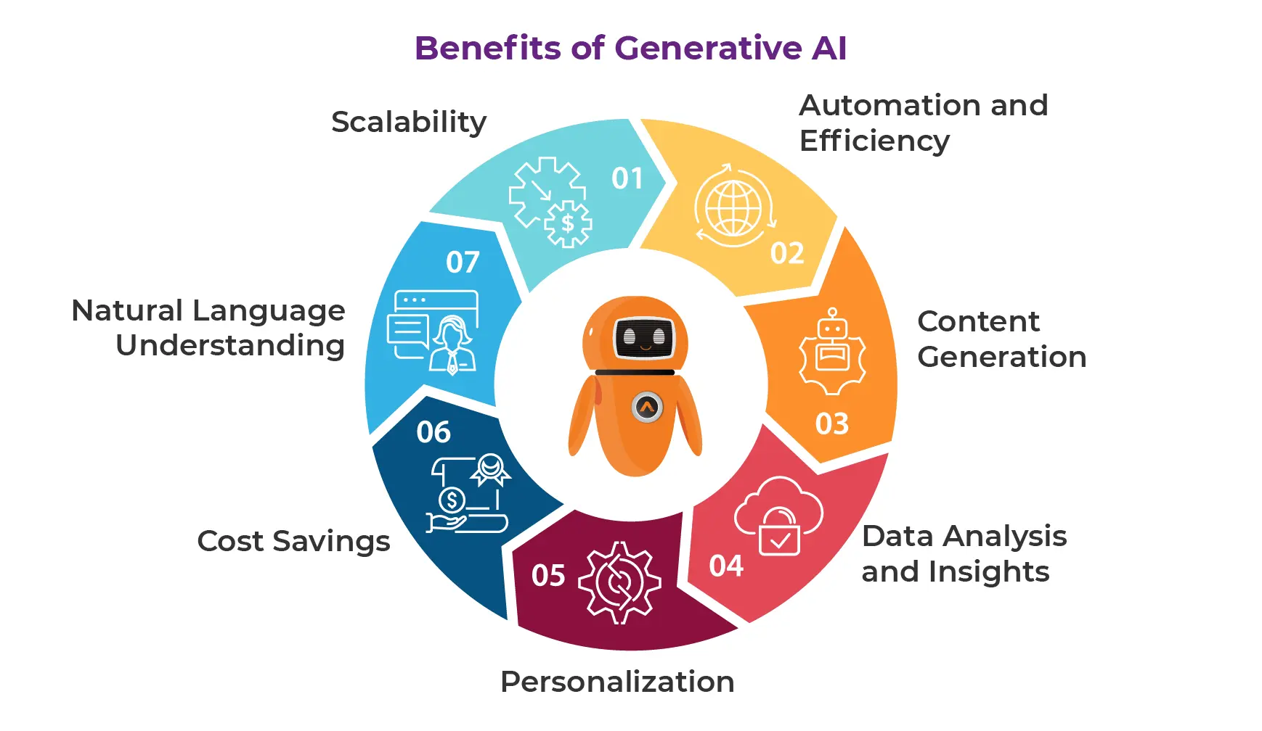
5/8

Slide 7

Challenges and Limitations of Generative AI
Ethical Concerns:
Fake Information
Copyright
Creativity and Originality
Not Innovating
Predictable Output
Privacy and Security
Privacy Risks
Security Threats
Resource Intensity
High Costs
Environmental Impact
6/8

Slide 8

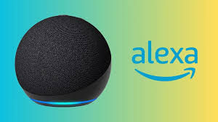
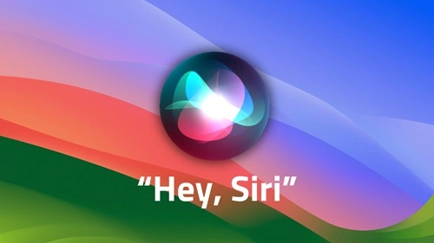
Future of Generative AI
Better Creativity
More Creative Content.
Personalized Content.
Education and Learning
Personalized Learning
Smart Tutors
Smarter Assistants
Enhanced Virtual Helpers (Siri , Alexa)
Human-like Conversations
Improved Healthcare
Faster Diagnoses
Personalized Treatments
7/8

Slide 9
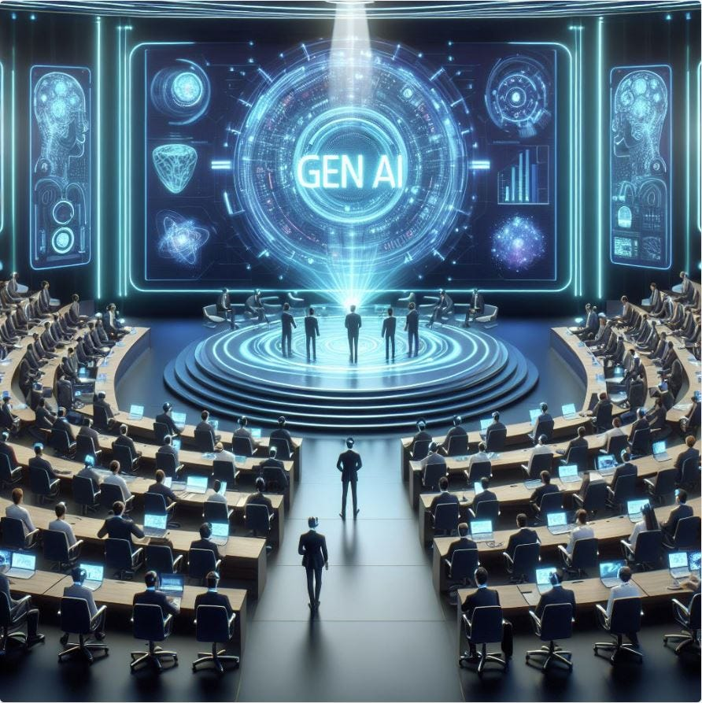

CONCLUSION
Empowering Creativity: Generative AI bridges human imagination with cutting-edge technology.
Transforming Industries: From art to medicine, it is revolutionizing how we work and innovate.
Balancing Potential and Ethics: Its power demands responsible use to ensure a positive impact.
Future-Ready: Generative AI is not just a tool—it's a catalyst for a smarter, more creative world.
8/8

Slide 10
Q N A !

